Slide 1
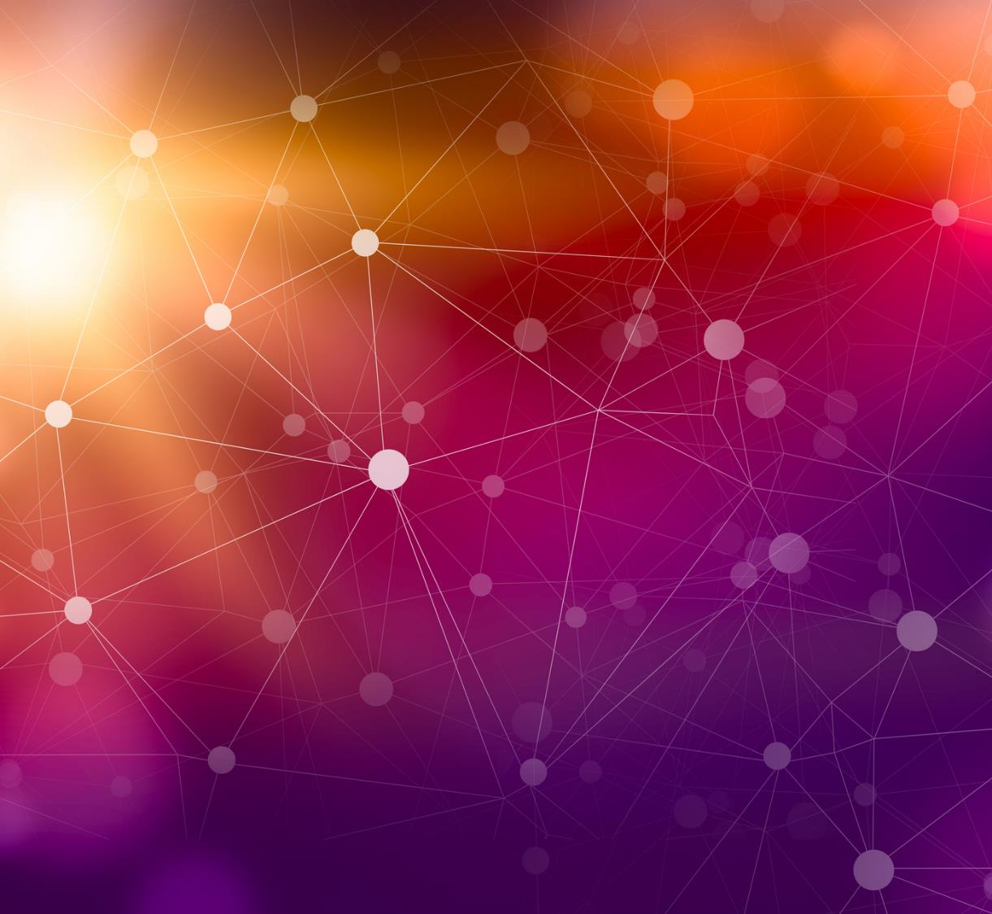
Revolutionizing Document Transformation: Unleashing the Power of LLMs for Document processing
Ashish Easow
* Assistant credits – ChatGPT

Slide 2
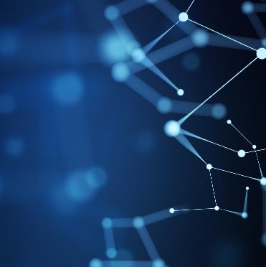
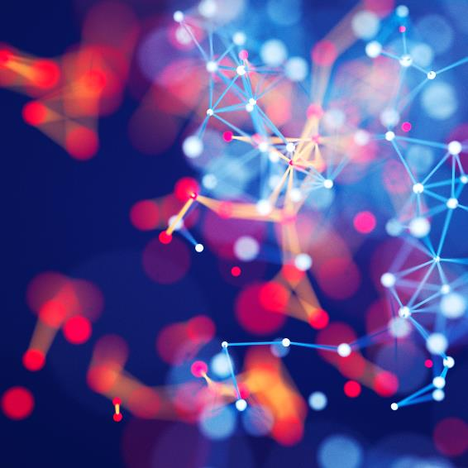
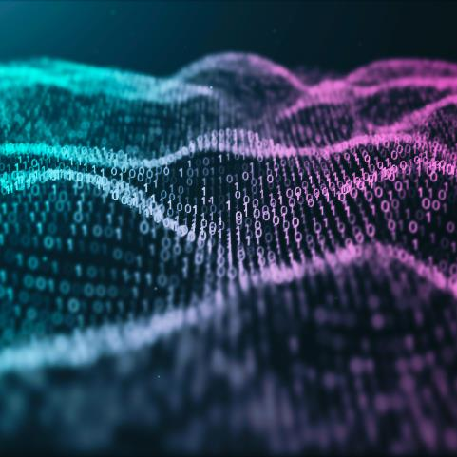
Agenda
Introduction
Design
POC Demo
Conclusion

Slide 3

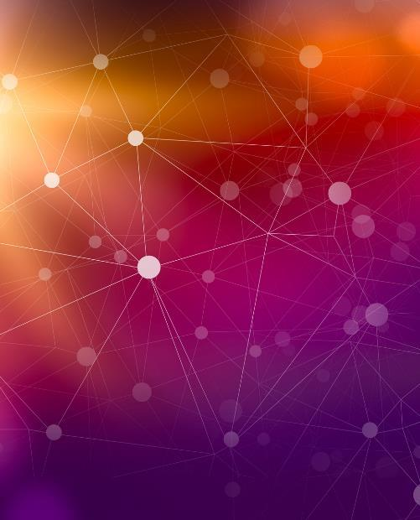

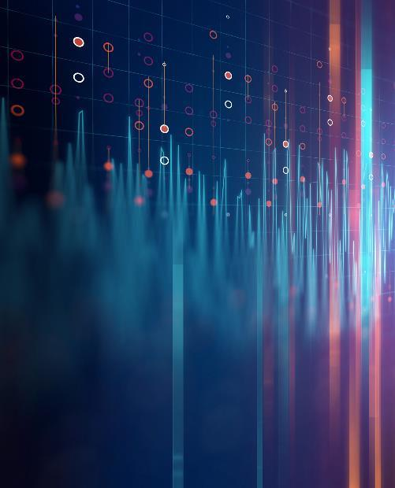
Introduction
Digital document reading use cases are none of the most common ones used by enterprises to get benefits from automation programs and Large language models like ChatGPT, Bard, LLAMA2, Mistral 7B amongst others are at the forefront of digital innovation. So, what's stopping us from combining both.
Notes:
As businesses grapple with vast amounts of unstructured data locked within PDF documents, the need for a solution that not only reads but truly understands the content is paramount. Traditional Optical Character Recognition (OCR) systems, while proficient at recognizing text, often fall short when it comes to deciphering the nuances of complex document structures. This is where LLMs step in to take the lead.
Imagine a scenario where every document, regardless of its complexity, is effortlessly translated into a structured JSON format, preserving the integrity of the data while making it infinitely more accessible and usable. This demo showcases precisely that capability.

Slide 4




POC Architecture
Read Raw/Unstructured data from documents
(Digital using pdfplumber or Scanned using Tesseract)
2. Integrate with LLM and send unstructured data for processing
LLM
Python
Documents Folder
Structured or Unstructured
3. Produce structured output by LLM as described by prompt
Applications
RPA/BP
4. Enter into applications by RPA
Notes:
Powered by Python, our demo harnesses the formidable capabilities of LLMs to read, interpret, and convert unstructured PDF data into meticulously structured JSONs. The beauty of this approach lies in the innate understanding that LLMs bring to the table. Unlike OCRs that merely recognize characters, LLMs comprehend the context, discern relationships between elements, and generate structured outputs that mirror the true essence of the document.
Through an intuitive and seamless process, the demo navigates through complex document layouts, varying fonts, and diverse content types, ensuring a reliable and consistent transformation every time. Witness firsthand how LLMs effortlessly handle the intricacies of invoices (demo), legal documents (demo) transcending the limitations of traditional OCR technology.
The same can be applied to research papers, invoices, and more.

Slide 5

Conclusion
With the integration of LLM’s the previous task which required ML training, preparation, and quite bit of development today can be done in 1/10th or less of time and effort. This demo just took me a few hours, though I’ll be honest and say every software has its own caveats and it won't be as simple as a snap.
Notes:
The implications of this advancement are profound. Businesses can now streamline their data extraction processes, enhance decision-making based on accurately interpreted information, and significantly reduce the time and effort spent on manual data structuring. The era of converting unstructured PDFs to structured JSONs has arrived, and it's powered by the unparalleled intelligence of LLMs.
The question which still needs humans to take a decision, when and how to use this.
Maintenance of production systems cost anything between 1.5 to 12 times the implementation costs, it needs to be done in a proper way and it needs to be worth it.
The next wave will be about document processing software’s scaling up for the future and using LLM’s.

Slide 6
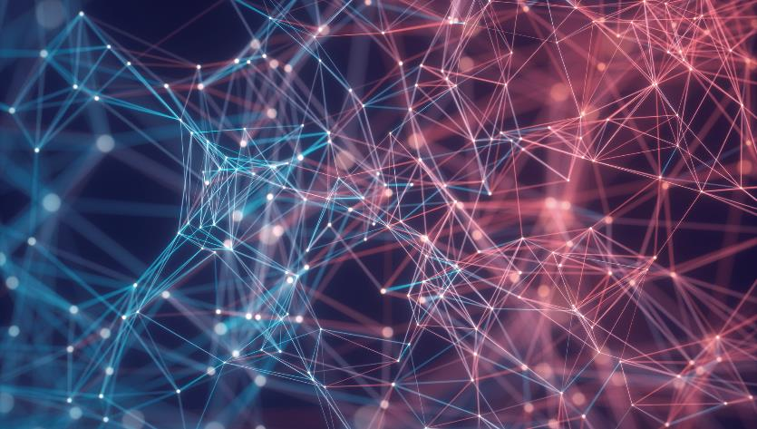

Thank You
GIT Repo: https://github.com/ashz30/LLMDocumentReading
Linkedin: https://www.linkedin.com/in/ashz30/
Youtube : https://www.youtube.com/@ashz31

